Slide 1
Graft Placement:
Most common cause of technical failure is improper graft placement
Essential for successful ACL reconstruction^{[8]}
Complications caused by poor graft placement cannot be overcome by:
Best graft strength
Best fixation strength
Best rehabilitation program

Slide 2
Graft Placement:
Principles:
Impingement:
Graft impinges on surrounding anatomical boundaries
Isometry:
Graft length changes during knee range of motion

Slide 3
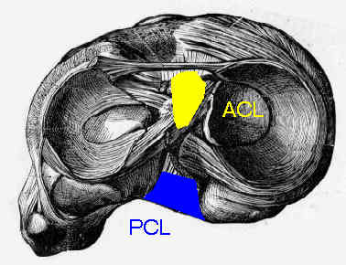
Graft Placement: Isometry
Isometry:
ACL graft length change during knee ROM
Causes stretching / failure of graft leading to anterior laxity
Oversimplified theory… but still applicable

Slide 4
Graft Placement: Isometry
Usually determined after ACL graft implanted by measuring graft motion with knee ROM
TOO LATE TO CHANGE !!

Slide 5
Graft Placement:
SOLUTION:
Computer Assisted ACL reconstruction
Computer assisted choice of tunnel insertion points based on impingement and isometry
Computer +/- image guided tunnel placement with increased accuracy and consistency.

Slide 6
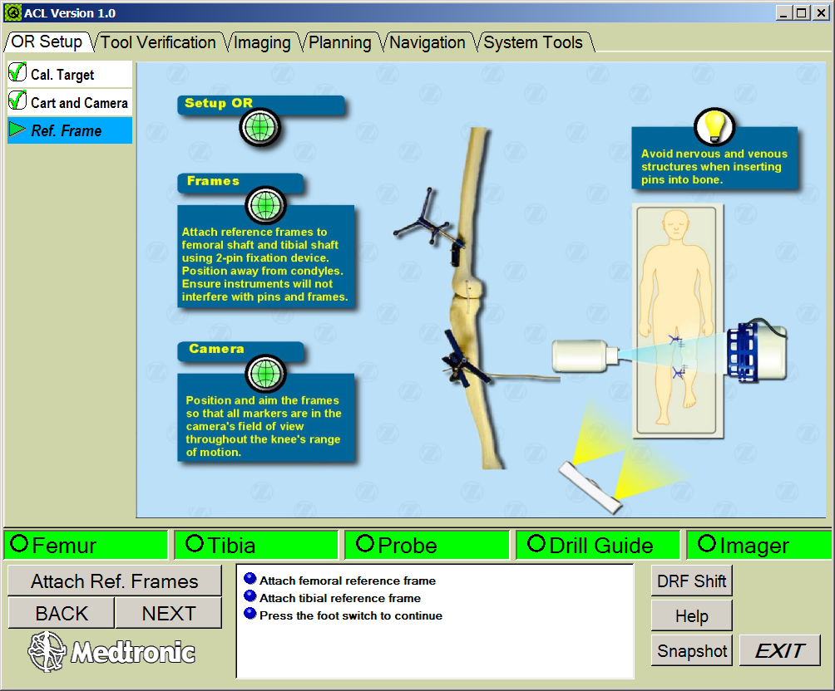
Graft Placement: Computer Guided ACL Recon.

Slide 7
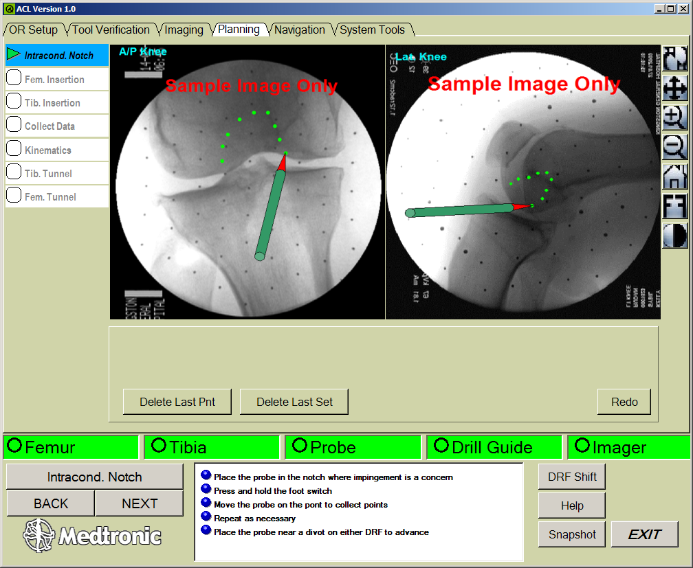
Graft Placement: Computer Guided ACL Recon.
Painting the Notch:
Collecting location of impingement anatomy

Slide 8
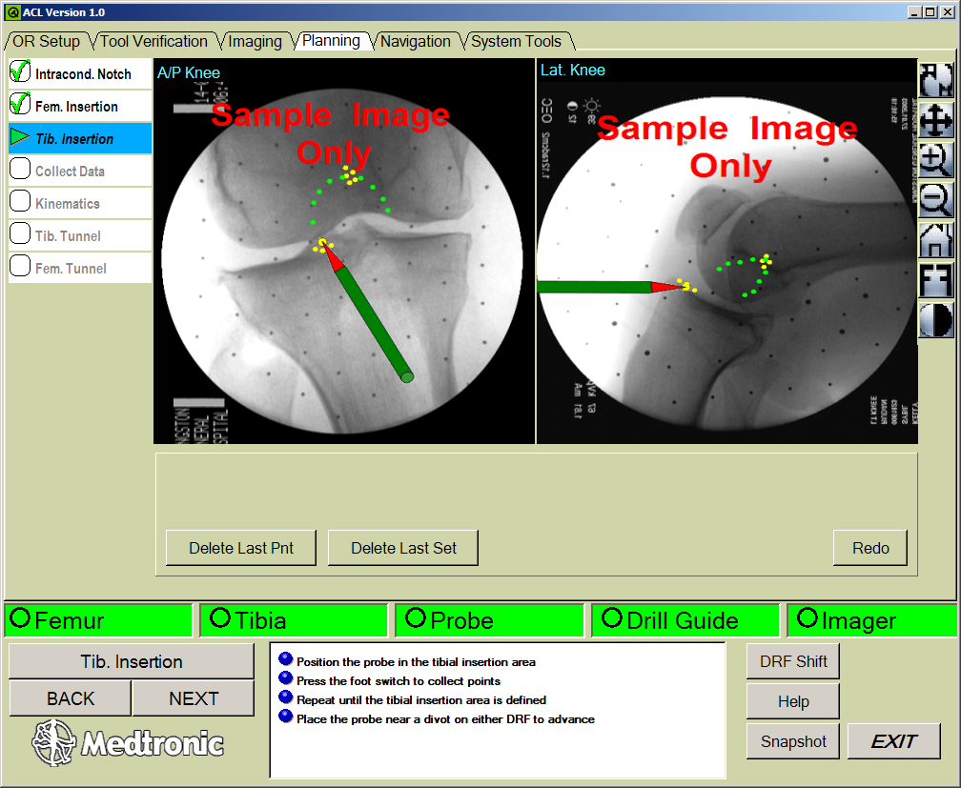
Graft Placement: Computer Guided ACL Recon.
Selection of tibial and femoral insertion points:
Surgeon experience used to select “best” location for ACL

Slide 9
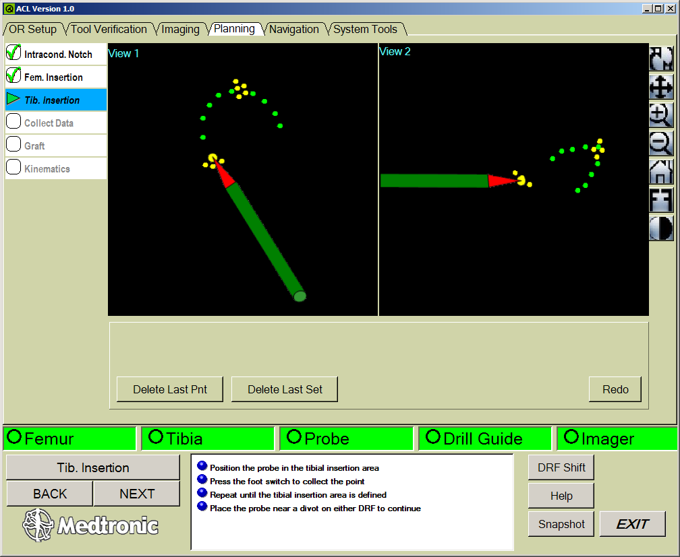
Graft Placement: Computer Guided ACL Recon.
Non-Image Guided:
Same principles applied without X-rays

Slide 10
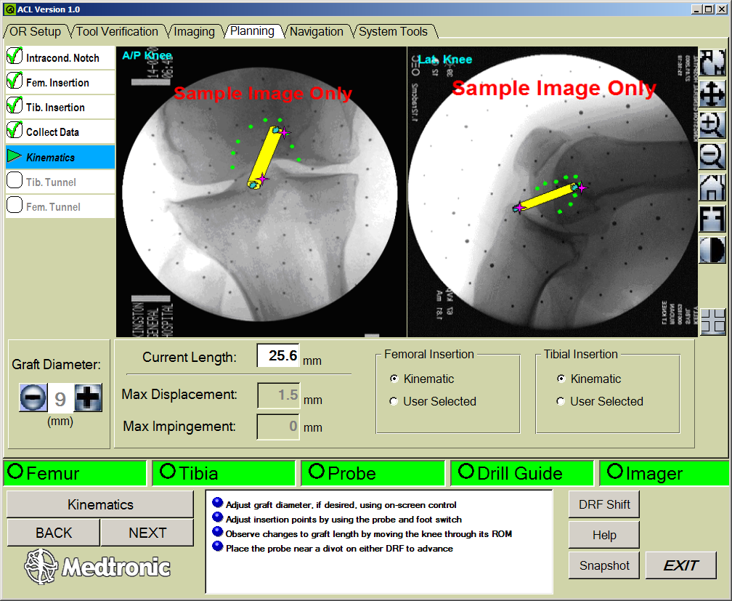
Graft Placement: Computer Guided ACL Recon.
Collection of Kinematic data:
Knee moved through ROM
Impingement & Isometry data collected
Graft drawn on kinematically determined isometric points with adjustable diameter
Impingement highlighted on notch “cloud”

Slide 11
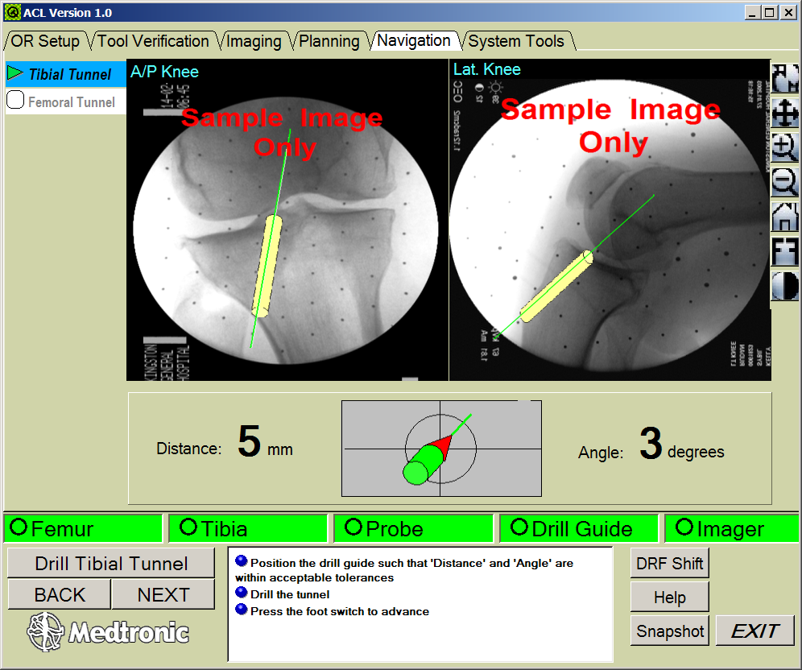
Graft Placement: Computer Guided ACL Recon.
Navigation:
Computer used to assist in drilling tibial and femoral tunnels in chosen location

Slide 12
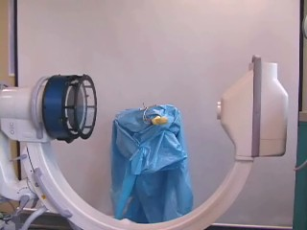
Graft Placement: Computer Guided ACL Recon.
Navigated Fluoroscopy:
Find two X-ray cones from source to detector, in local coordinates
Optical tracking links 3D coordinates of images to the surgical tools, the patient’s anatomy and a library of 3D objects or anatomical models
MICCAI Conference 2001, 2003

Slide 13
Graft Placement: Computer Guided ACL Recon.
CAS OR Setup:
Collecting location of impingement anatomy

Slide 14
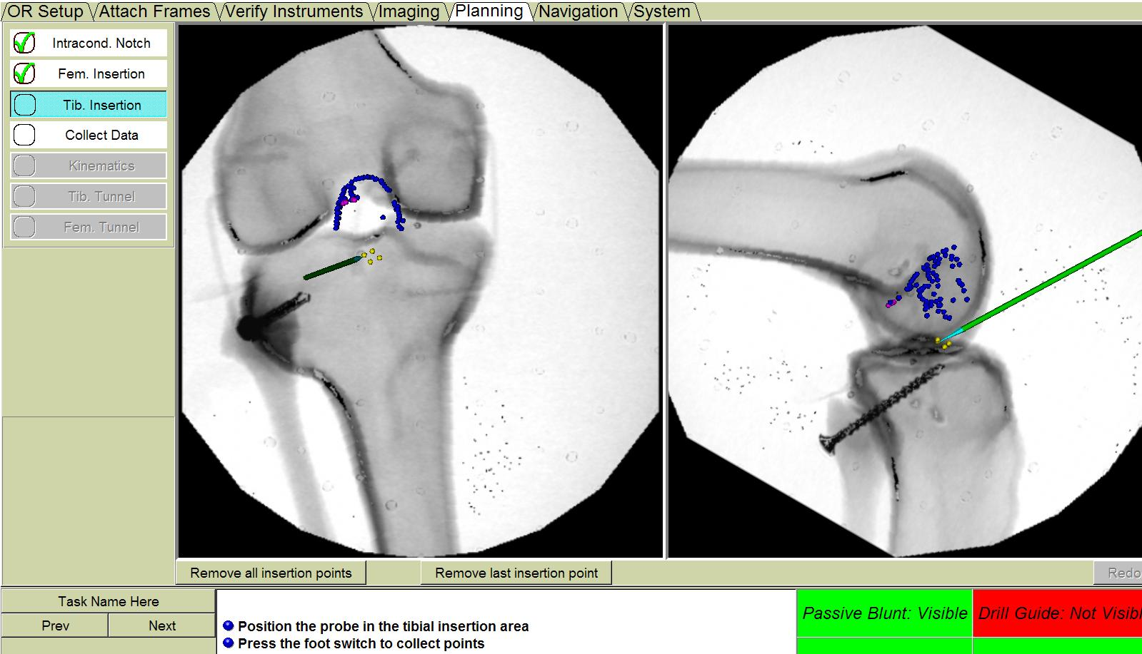
Graft Placement: Computer Guided ACL Recon.
Painting the Notch:
Collecting location of impingement anatomy
Selection of ACL insertion points:
Surgeon experience used to select “best” location for ACL

Slide 15
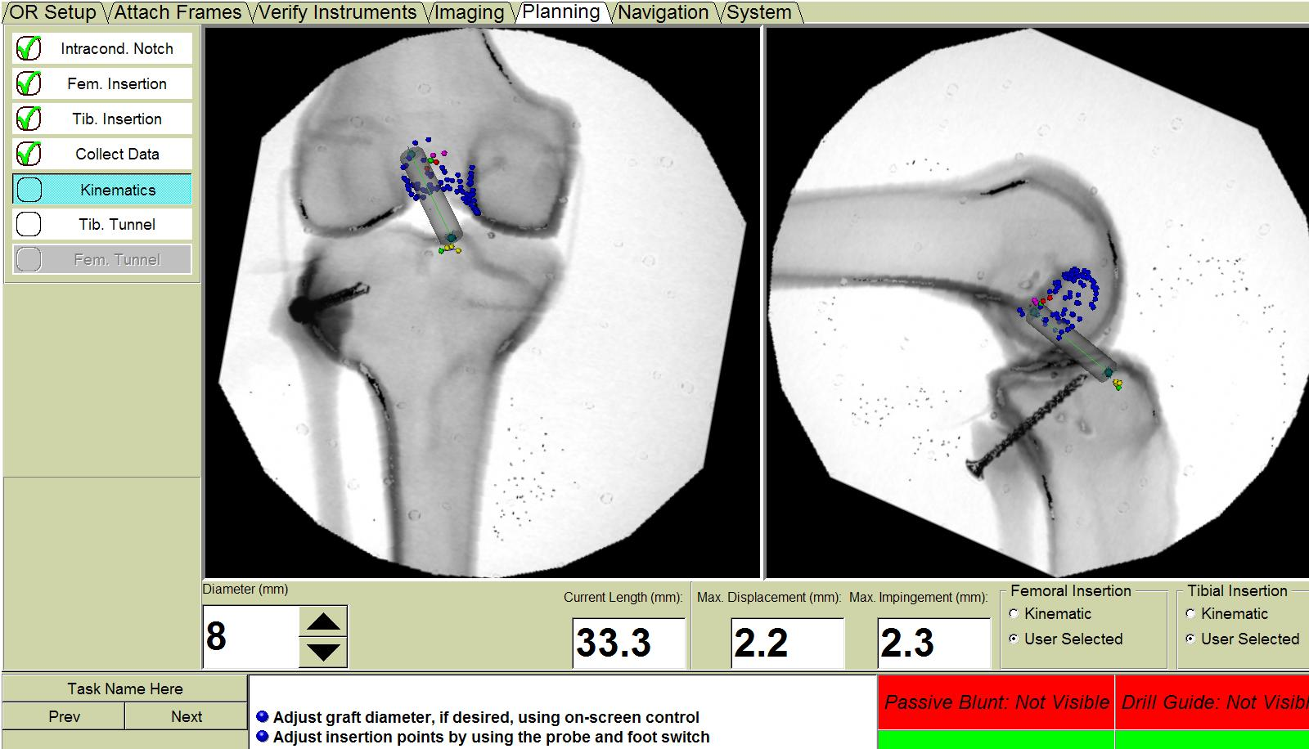
Graft Placement: Computer Guided ACL Recon.
Collection of Kinematic data:
Knee moved through ROM
Impingement & Isometry data collected
Graft drawn on kinematically determined isometric points with adjustable diameter
Impingement highlighted on notch “cloud”

Slide 16
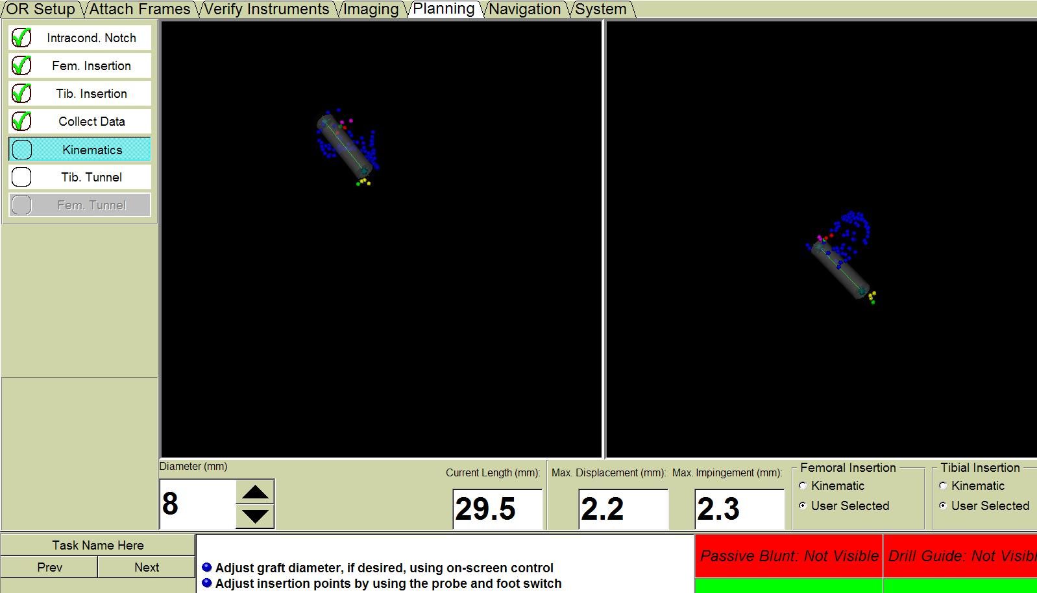
Graft Placement: Computer Guided ACL Recon.
Non-Image Guided:
Same principles applied without X-rays

Slide 17
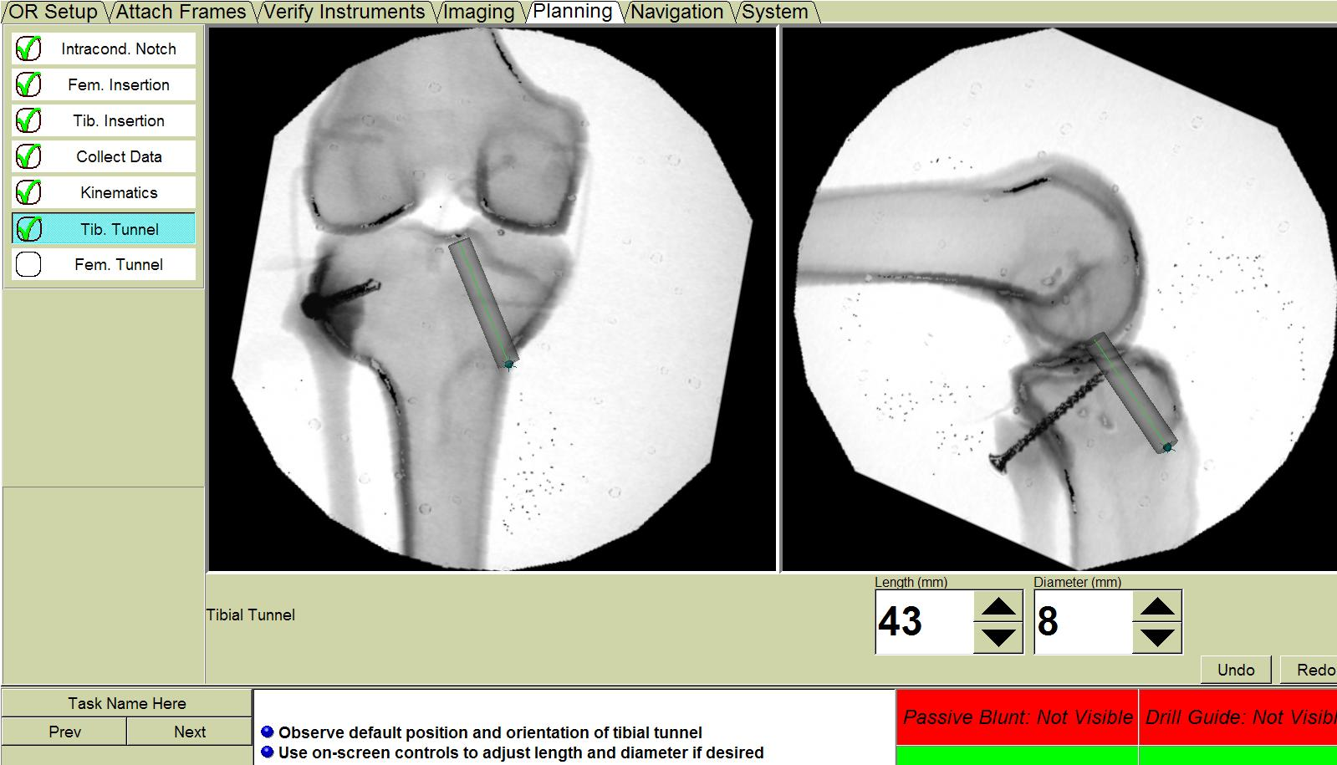
Graft Placement: Computer Guided ACL Recon.
Tibial Tunnel Planning:
Computer used to assist in drilling tibial and femoral tunnels in chosen location

Slide 18
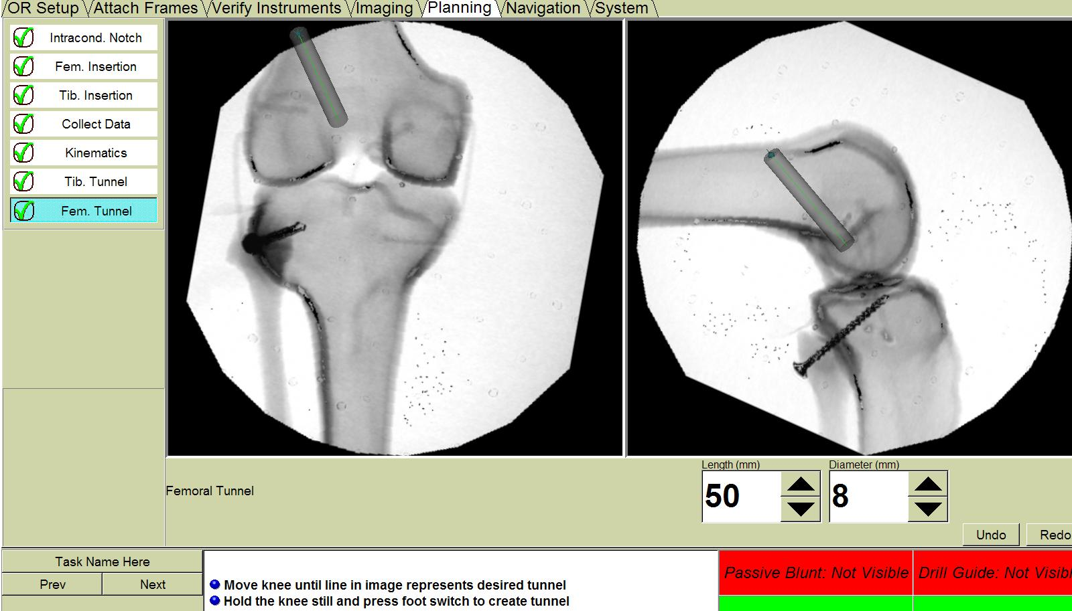
Graft Placement: Computer Guided ACL Recon.
Femoral Tunnel Planning:
Computer used to assist in drilling tibial and femoral tunnels in chosen location

Slide 19
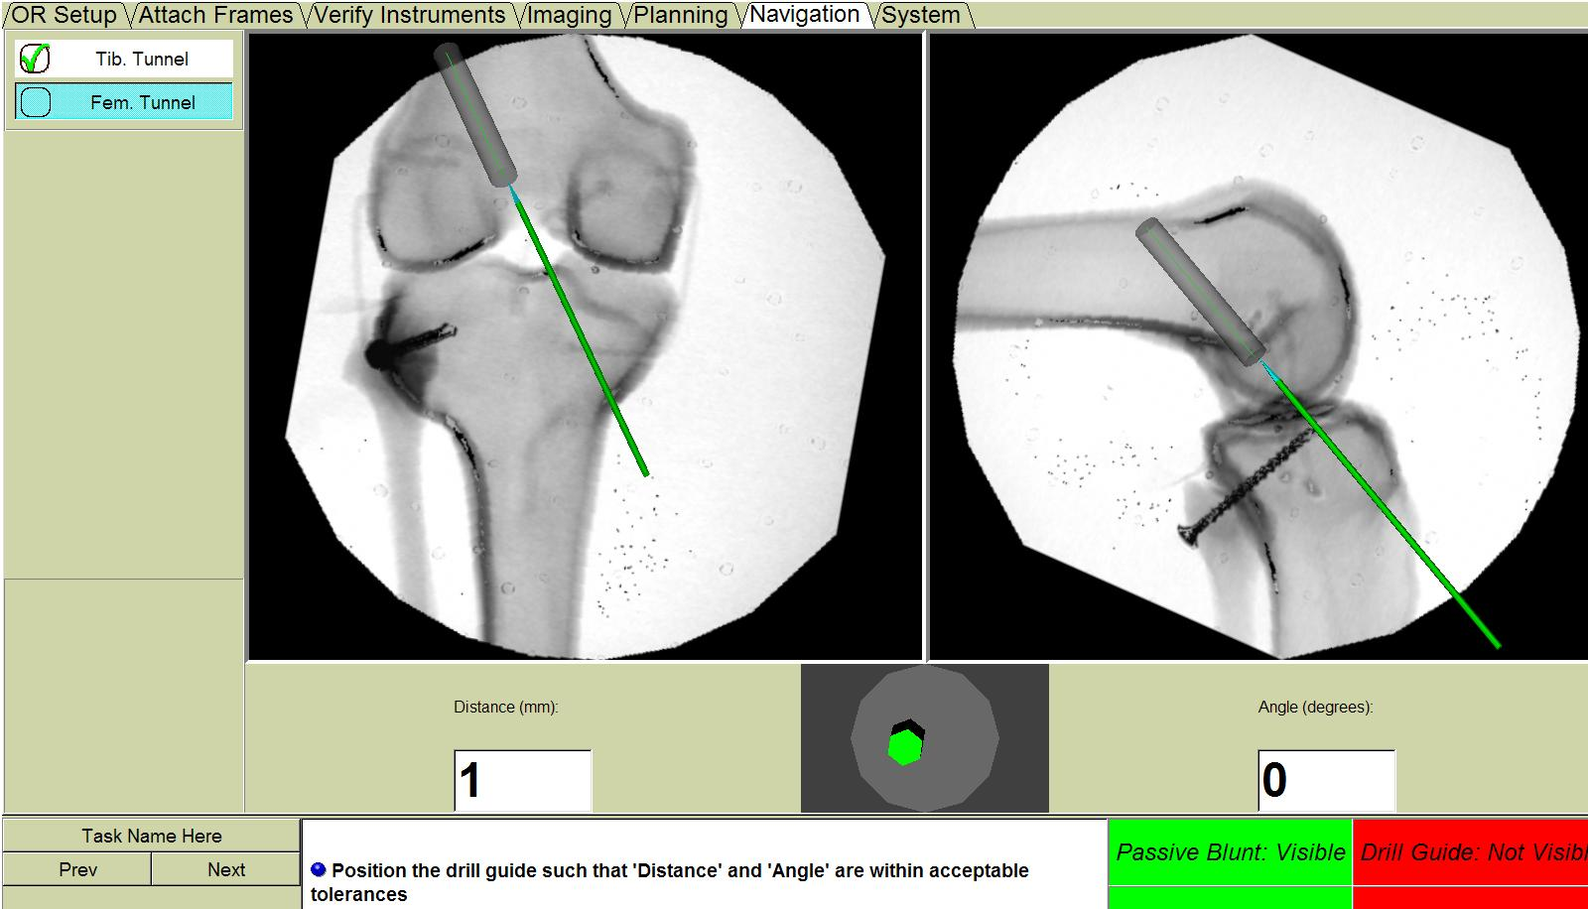
Graft Placement: Computer Guided ACL Recon.
Navigation:
Computer used to assist in drilling tibial and femoral tunnels in chosen location

